Slide 1

Confusion Matrix
Presented by kodali va run

Slide 2
What is a confusion matrix
A Confusion matrix is a performance measurement for machine learning classification problem where output can be two or more classes.
It is a table with 4 different combinations of predicted and actual values.

Slide 3
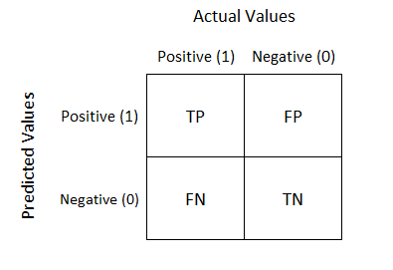

Slide 4
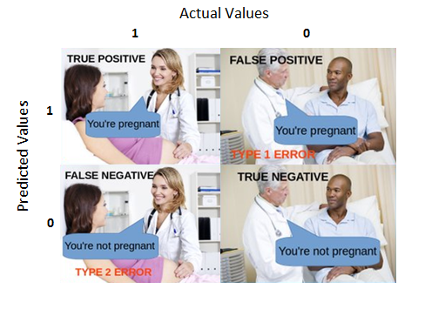

Slide 5
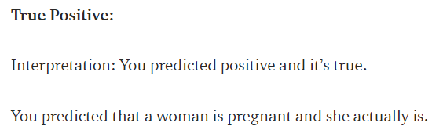
Confusion Matrix(tp)

Slide 6
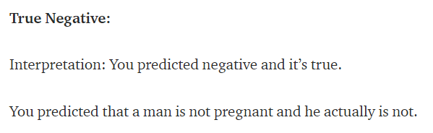
Confusion Matrix(tn)

Slide 7
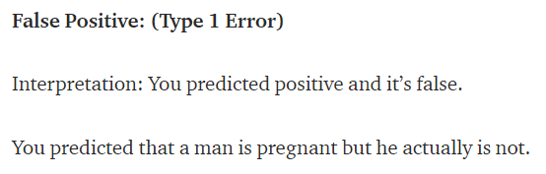
Confusion Matrix(fp)

Slide 8
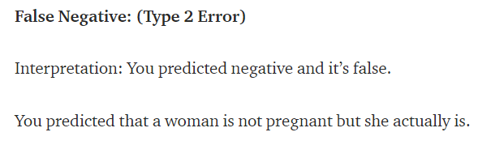
Confusion Matrix(fn)

Slide 9
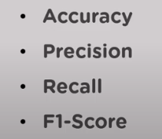
Confusion matrix metrics
Confusion matrix metrics are performance measures which help us find the accuracy of our classifier. There are four main metrics :

Slide 10
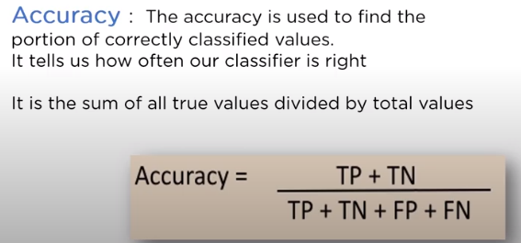

Slide 11
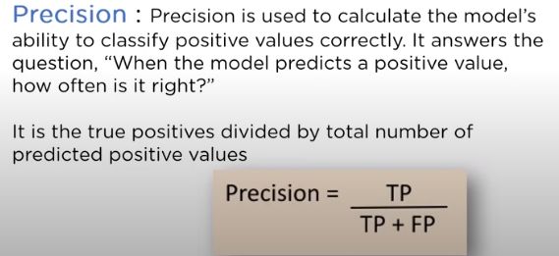

Slide 12
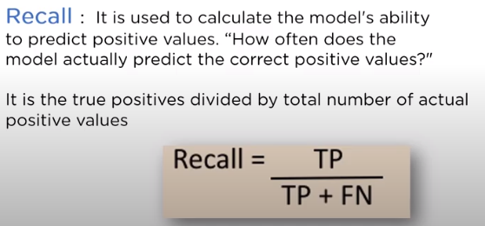

Slide 13
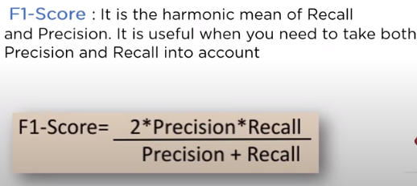

Slide 14
Need for confusion matrices
Classification Models have multiple output categories. Most error measures will tell us the total error in our model, but we cannot use it to find out individual instances of errors in our model.
Generally, We use accuracy for Balanced dataset and Recall, Precision and F1-Score for Imbalanced dataset.

Slide 15
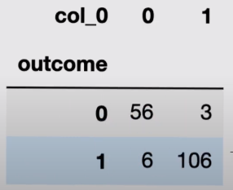
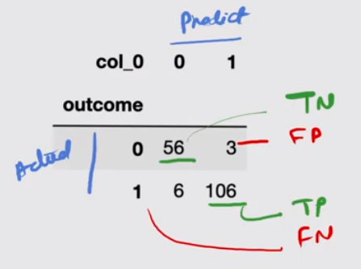
Example : Cancer patient (yes/no)

Slide 16
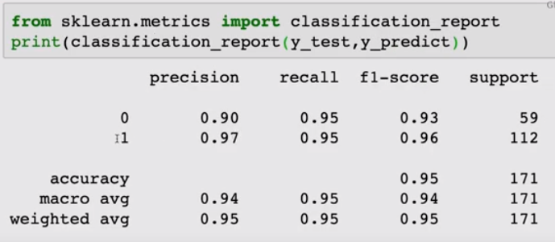

Classification report and confusion matrix in python code

Slide 17


Slide 18
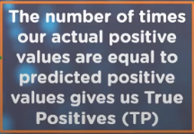
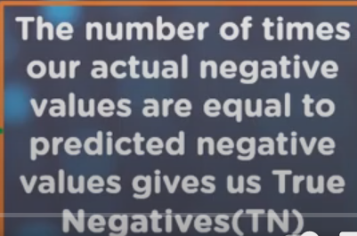
Confusion Matrix TP & TN

Slide 19
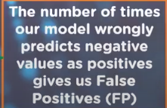
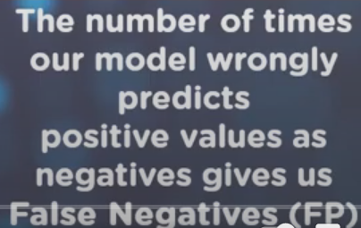
Confusion Matrix FP & FP

